Slide 1

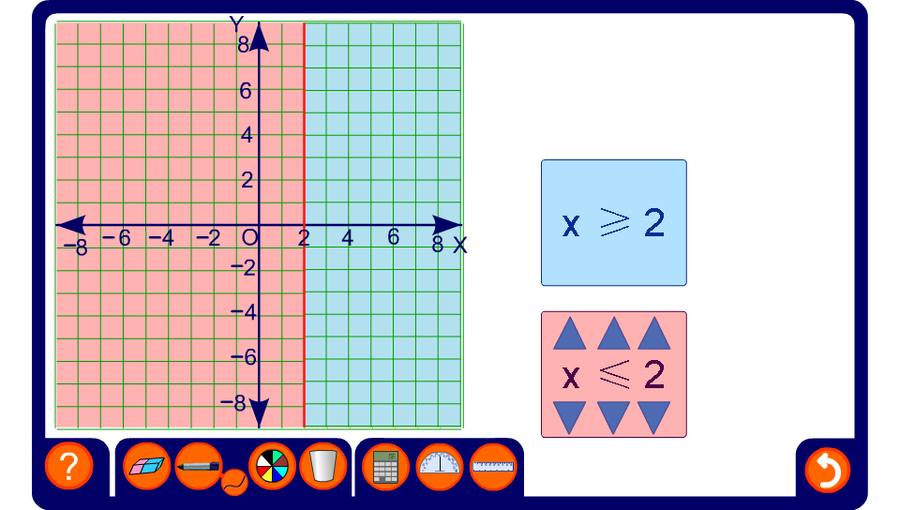


Vertical regions 1
Notes:
Demonstrate a variety of regions involving x. Stress that a solid line means that the points on the line are included and a dotted line means that they are not included.
Tell pupils that it is always a good idea to take a few points in the required region and check that the co-ordinates satisfy the required inequality.

Slide 2
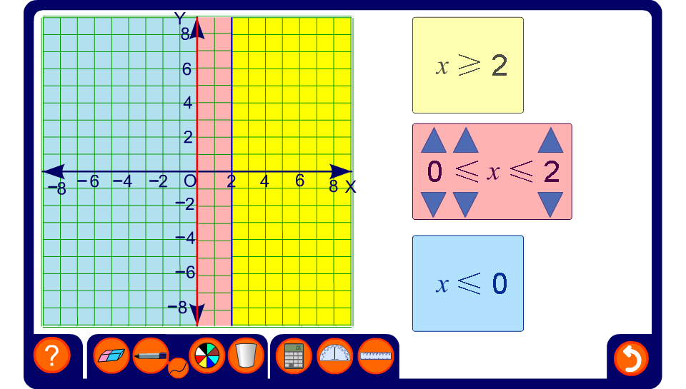
Vertical regions 2
Notes:
Demonstrate the effect of combining more than one region involving x.

